Slide 1
MULTI FACTOR INVESTING
A Quantitative Approach For Stock Evaluation

Slide 2
FACTORS CONSIDERED:
Quality
Value
Growth
Momentum

Slide 3
Quality Factor:
Quality factor tries to capture the durability of business
It consist of following sub factors:
Return on Equity
Debt to Equity
EPS Variability

Slide 4
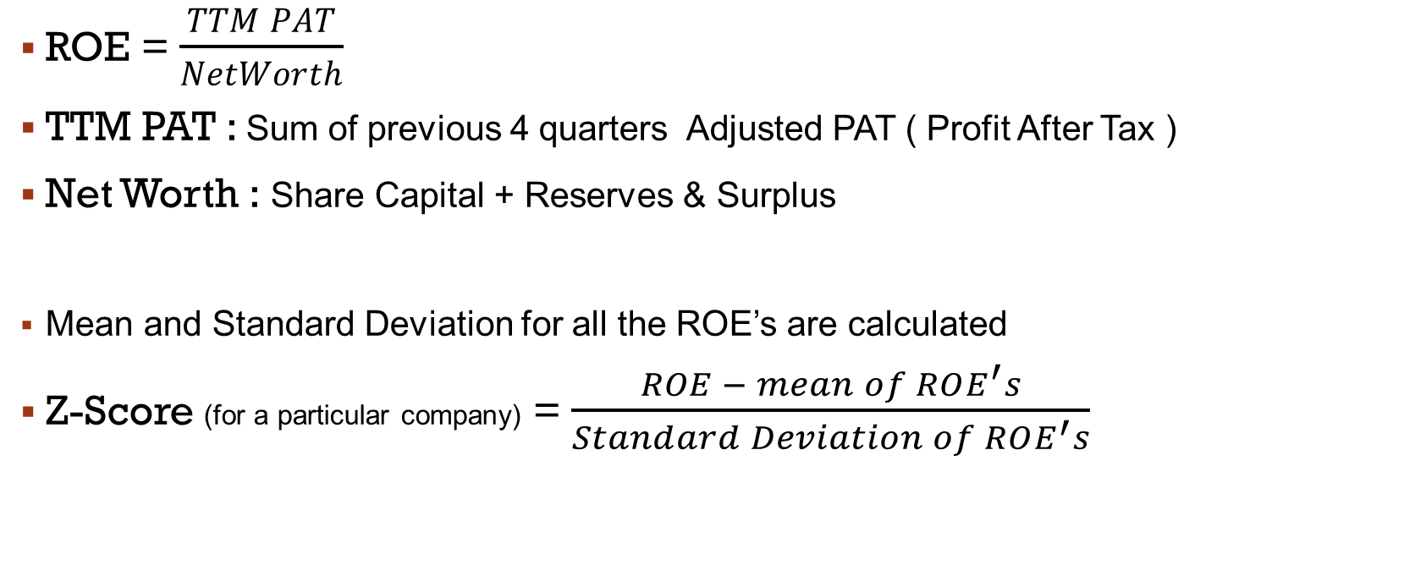
Quality Factor: 1. Return on equity
ROE = $\frac{TTM PAT}{NetWorth}$
TTM PAT : Sum of previous 4 quarters Adjusted PAT ( Profit After Tax )
Net Worth : Share Capital + Reserves & Surplus
Mean and Standard Deviation for all the ROE’s are calculated
Z-Score (for a particular company) = $\frac{ROE − mean of ROE^{′}s}{Standard Deviation of ROE^{′}s}$

Slide 5
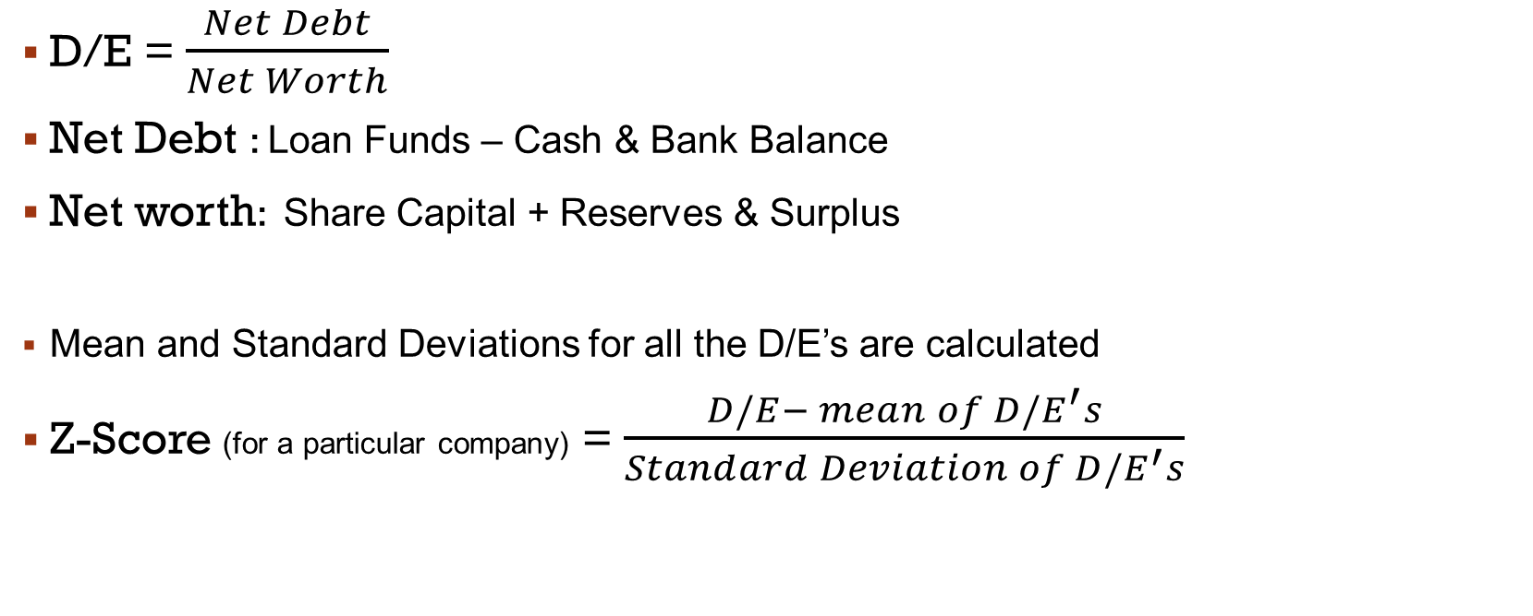
Quality Factor: 2. Debt to equity
D/E = $\frac{Net Debt}{Net Worth}$
Net Debt : Loan Funds – Cash & Bank Balance
Net worth: Share Capital + Reserves & Surplus
Mean and Standard Deviations for all the D/E’s are calculated
Z-Score (for a particular company) = $\frac{D/E− mean of D/E^{′}s}{Standard Deviation of D/E^{′}s}$

Slide 6
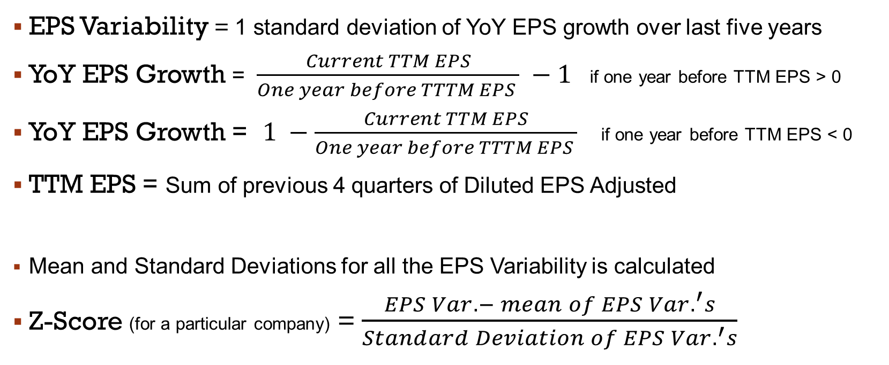
Quality Factor: 3. EPS VARIABILITY
EPS Variability = 1 standard deviation of YoY EPS growth over last five years
YoY EPS Growth = $\frac{Current TTM EPS}{One year before TTTM EPS } −1$if one year before TTM EPS > 0
YoY EPS Growth = $1 −\frac{Current TTM EPS}{One year before TTTM EPS }$if one year before TTM EPS < 0
TTM EPS = Sum of previous 4 quarters of Diluted EPS Adjusted
Mean and Standard Deviations for all the EPS Variability is calculated
Z-Score (for a particular company) = $\frac{EPS Var.− mean of EPS Var.^{′}s}{Standard Deviation of EPS Var.^{′}s}$

Slide 7
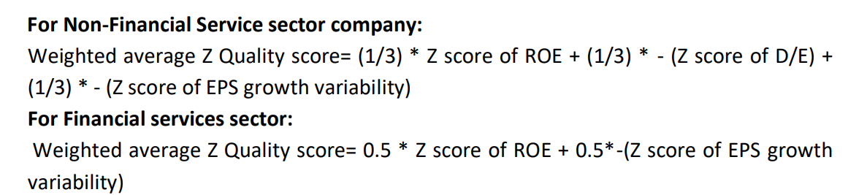
Quality Z Score:

Slide 8
Value factor:
Value factor uses valuation multiples to rank companies
It consists of following sub factors:
TTM P/E Ratio
BV/P Ratio
DPS/P Ratio

Slide 9
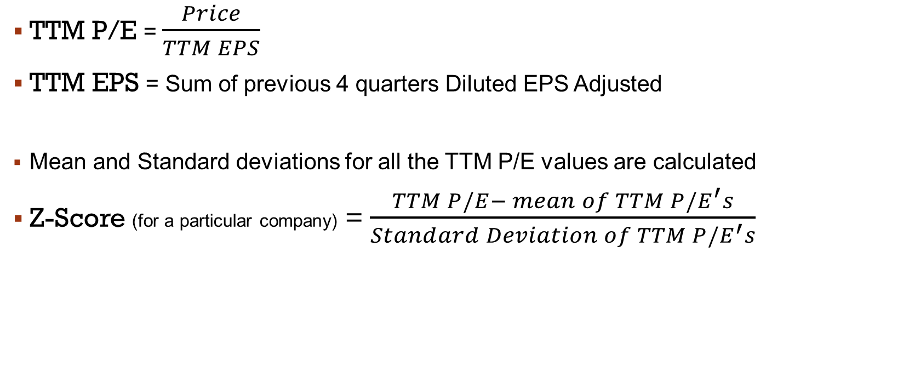
Value Factor: 1. ttm p/e
TTM P/E = $\frac{Price}{TTM EPS}$
TTM EPS = Sum of previous 4 quarters Diluted EPS Adjusted
Mean and Standard deviations for all the TTM P/E values are calculated
Z-Score (for a particular company) = $\frac{TTM P/E− mean of TTM P/E^{′}s}{Standard Deviation of TTM P/E^{′}s}$

Slide 10
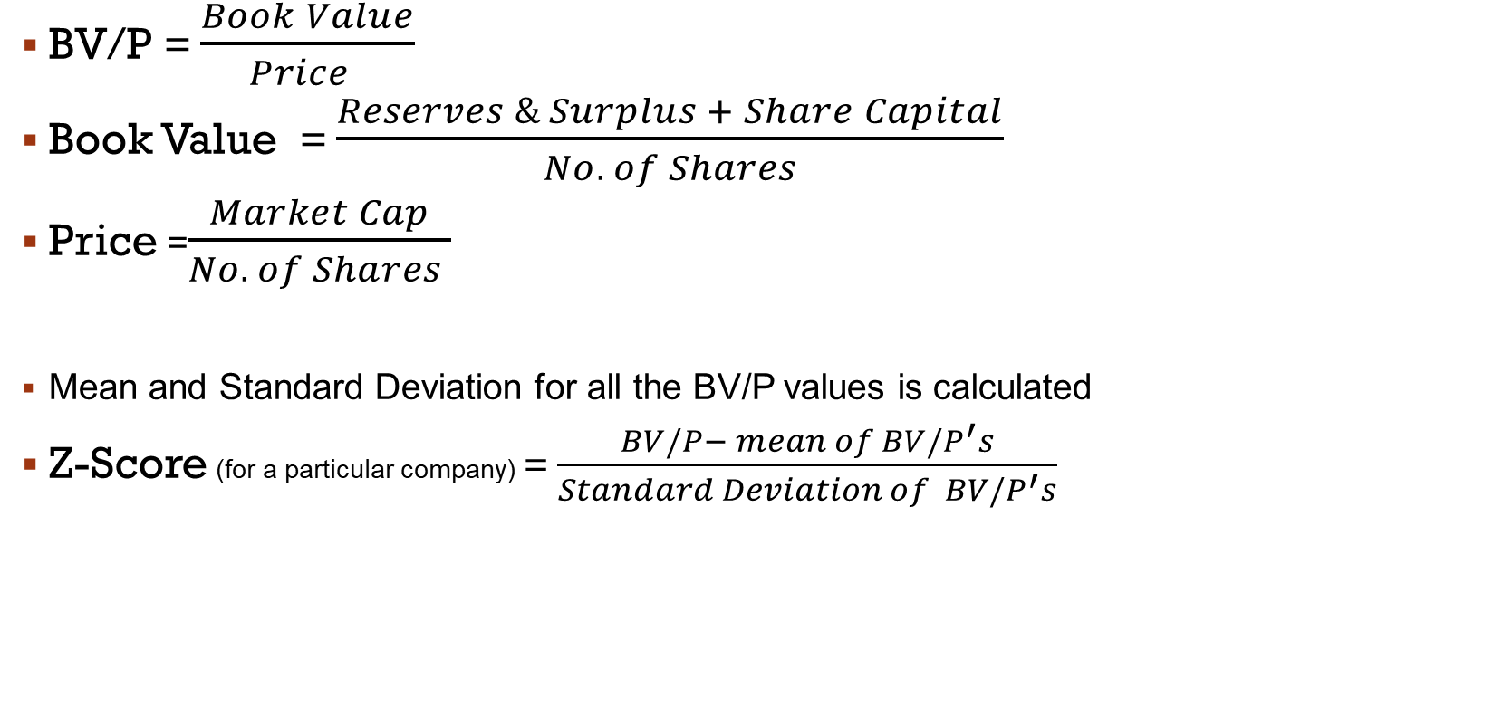
Value Factor: 2. Bv/p
BV/P = $\frac{Book Value}{Price }$
Book Value = $\frac{Reserves \& Surplus + Share Capital}{No. of Shares}$
Price =$\frac{Market Cap}{No. of Shares }$
Mean and Standard Deviation for all the BV/P values is calculated
Z-Score (for a particular company) = $\frac{BV/P− mean of BV/P^{′}s}{Standard Deviation of BV/P^{′}s}$

Slide 11
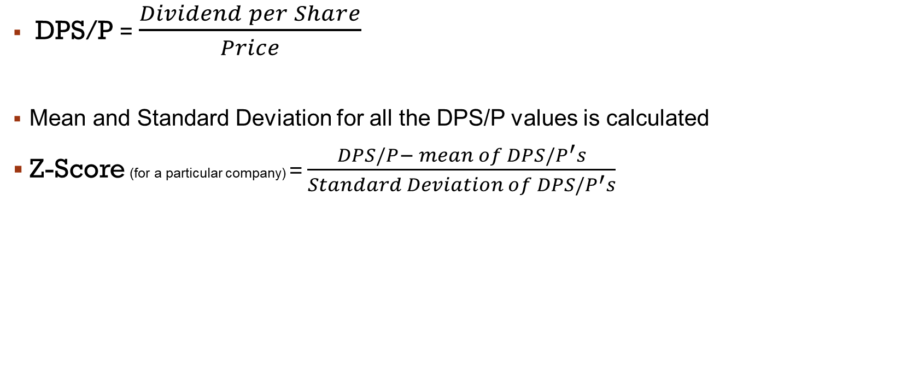
Value Factor: 3. DPS/P
DPS/P = $\frac{Dividend per Share}{Price}$
Mean and Standard Deviation for all the DPS/P values is calculated
Z-Score (for a particular company) = $\frac{DPS/P− mean of DPS/P^{′}s}{Standard Deviation of DPS/P^{′}s}$

Slide 12

Value z-score:
Value Z-score is calculated as :
$− \frac{1}{3} Z_{TTM P/E}$ + $\frac{1}{3} Z_{BV/P}+\frac{1}{3} Z_{DPS/P}$

Slide 13
Growth factor:
Captures the company’s growth prospects
It includes the following sub factors:
Long-Term historical EPS growth
Long-term historical Sales growth
Current Internal Growth rate

Slide 14
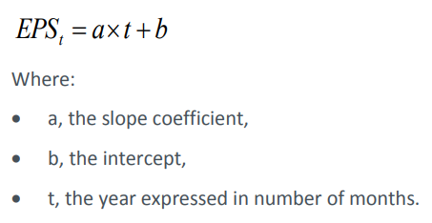
Growth factor: 1.LT historical EPS growth
For the calculation of the LT his EPS G, first a regression (ordinary least square method) is applied to the last 5 year TTM EPS.

Slide 15
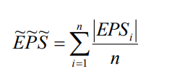
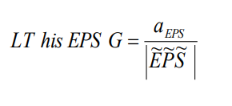
Growth factor: 1.LT historical EPS growth
Then average absolute EPS is estimated:
The EPS growth trend is obtained by :

Slide 16

Growth factor: 1.LT historical EPS growth
Mean and Standard Deviation for LT his EPS growth trend is calculated
Z-Score (for a particular company) = $\frac{LTEPS_{g}− mean of LTEPS_{g}}{Standard Deviation of LTEPS_{g}}$

Slide 17
Growth factor: 2.LT historical sales growth
For the calculation of the LT his Sales G, first a regression (ordinary least square method) is applied to the last 5 yearly TTM Sales.
Sales_{t} = a * t + b
where :
a: slope coefficient
b: intercept
t: the years expressed in months

Slide 18
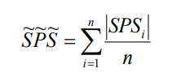
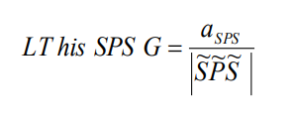
Growth factor: 2.LT historical sales growth
Then average absolute Sales is estimated :
Sales growth trend is obtained by :

Slide 19

Growth factor: 2.LT historical sales growth
Mean and Standard Deviation for LT his Sales growth trend is calculated
Z-Score (for a particular company) = $\frac{LTSales_{g}− mean of LTSales_{g}}{Standard Deviation of LTSales_{g}}$

Slide 20
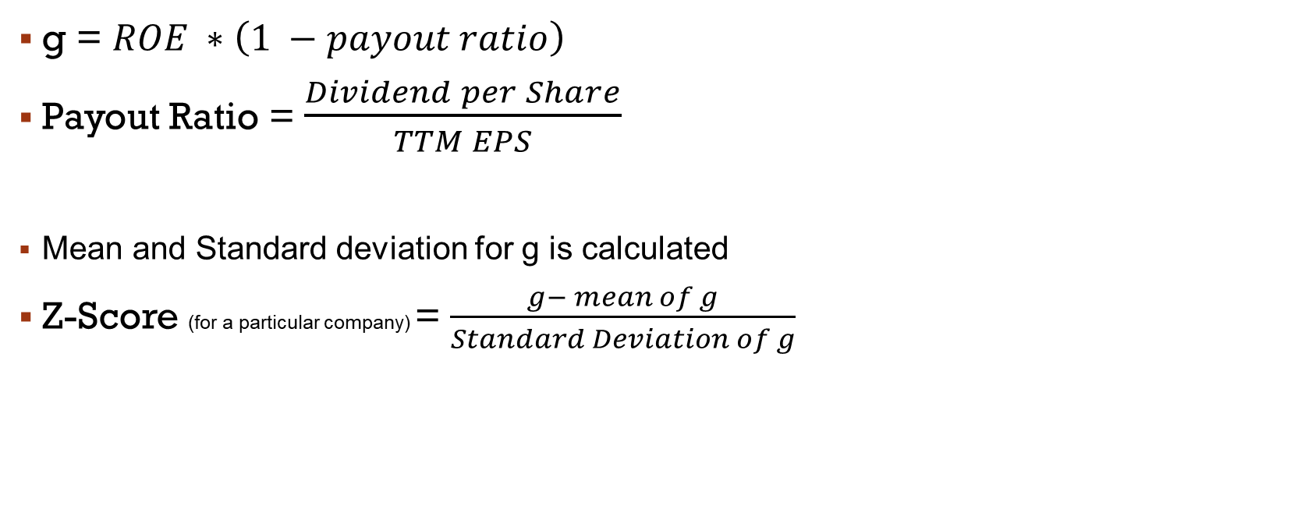
Growth factor: 3.current Internal Growth rate
g = $ROE ∗\left(1 −payout ratio\right)$
Payout Ratio = $\frac{Dividend per Share}{TTM EPS}$
Mean and Standard deviation for g is calculated
Z-Score (for a particular company) = $\frac{g− mean of g}{Standard Deviation of g}$

Slide 21

Growth z-score:
Growth factor Z-Score is calculated as :
$\frac{1}{3} LTEPS_{g}+\frac{1}{3}LTSales_{g}+\frac{1}{3}g$

Slide 22
Momentum factor
Momentum factor states that stocks that have outperformed recently are likely to continue to outperform and vice-versa
It includes the following sub factors:
6 month price momentum
12 month price momentum

Slide 23
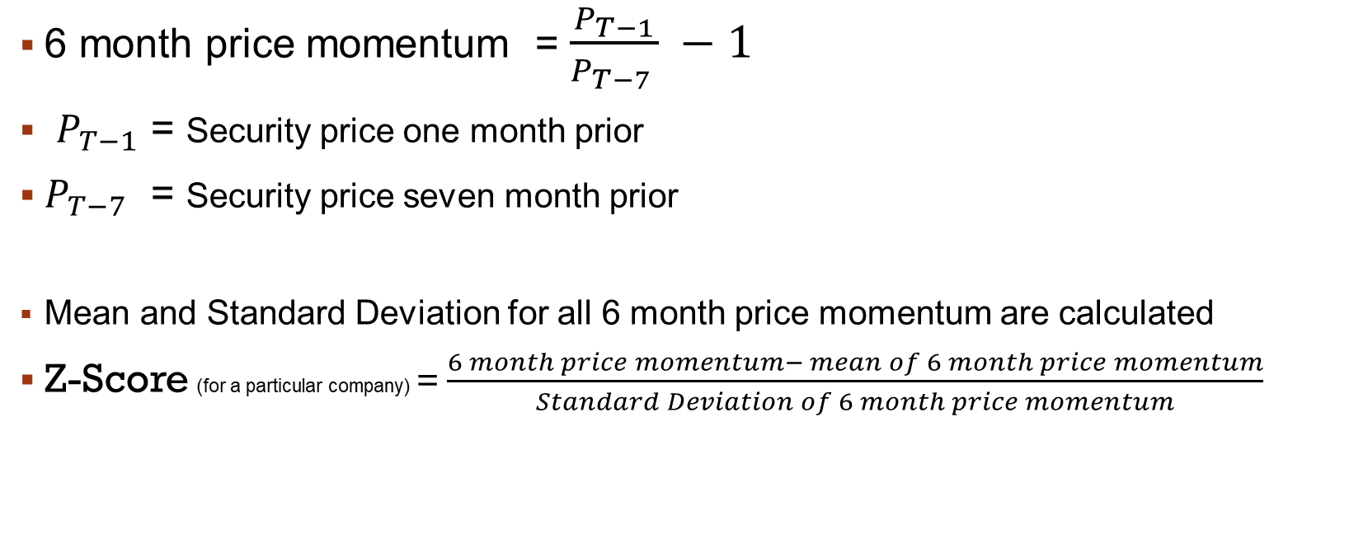
Momentum factor 1. 6 month price momentum
6 month price momentum = $\frac{P_{T−1}}{P_{T−7 }} −1$
$P_{T−1}$ = Security price one month prior
$P_{T−7}$ = Security price seven month prior
Mean and Standard Deviation for all 6 month price momentum are calculated
Z-Score (for a particular company) = $\frac{6 month price momentum− mean of 6 month price momentum}{Standard Deviation of 6 month price momentum}$

Slide 24

Momentum factor 1. 12 month price momentum
12 month price momentum = $\frac{P_{T−1}}{P_{T−13 }} −1$
$P_{T−1}$ = Security price one month prior
$P_{T−13}$ = Security price thirteen month prior
Mean and Standard Deviation for all 6 month price momentum are calculated
Z-Score (for a particular company) = $\frac{12 month price momentum− mean of 12 month price momentum}{Standard Deviation of 12 month price momentum}$

Slide 25

Momentum z-score:
Momentum Factor Z-Score is calculated as :
$\frac{1}{2}∗6 month price momemtum+\frac{1}{2}∗12 month price momentum$

Slide 26
adjustments:
As available Share Capital , Loan Funds, Cash & Bank Balance data was half-yearly, the succeeding quarters have been given same data
As available Reserves & Surplus data was half-yearly, the succeeding quarters have been given Reserves & Surplus + Adjusted PAT
For calculations , the EPS before Exceptional/Extraordinary Diluted is taken and adjusted for bonus and splits
As available Dividend per Share data was annual, the succeeding quarter have been given same data

Slide 27
Results:
STATIC EQUAL WEIGHTED

Slide 28
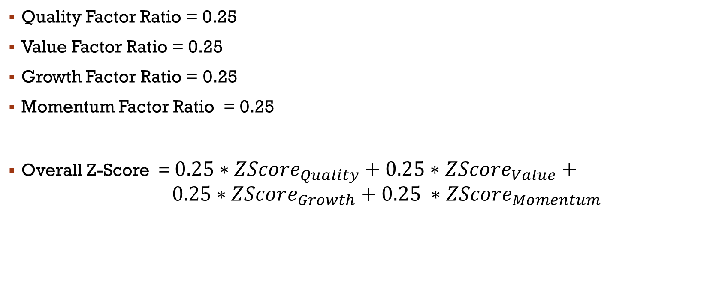
Equal ratio overall z-score
Quality Factor Ratio = 0.25
Value Factor Ratio = 0.25
Growth Factor Ratio = 0.25
Momentum Factor Ratio = 0.25
Overall Z-Score = $0.25∗{ZScore}_{Quality}+0.25∗ZScore_{Value}+ 0.25∗ZScore_{Growth}+0.25 ∗ZScore_{Momentum}$

Slide 29
July 2017
STATIC EQUAL WEIGHTED
TOP 10
Olectra Greentec
Uno Minda
Escorts Kubota
Suprajit Engg.
Lumax Industries
Subros
Steel Str. Wheel
Lumax Auto Tech.
Sundram Fasten.
Talbros Auto.
BOTTOM 10
Bosch
Tata Motors
Fiem Industries
Amara Raja Ener.
Ashok Leyland
The Hi-Tech Gear
SML ISUZU
Minda Corp
Atul Auto
Automotive Stamp

Slide 30
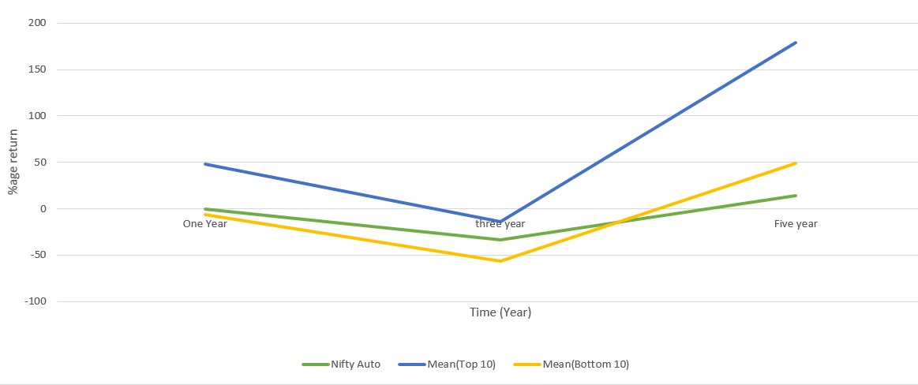
July 2017
STATIC EQUAL WEIGHTED
 | One Year(%) | Three year(%) | Five year(%)
Nifty Auto | -0.26 | -33.84 | 14
TOP 10 | 47.83 | -13.62 | 179.40
BOTTOM 10 | -6.69 | -56.09 | 48.80

Slide 31
FEB 2019
STATIC EQUAL WEIGHTED
TOP 10
Automotive Stamp
Lumax Auto Tech.
Automotive Axles
Olectra Greentec
M & M
Exide Inds.
ZF Commercial
Jamna Auto Inds.
Ashok Leyland
Suprajit Engg.
BOTTOM 10
India Motor Part
Atul Auto
Minda Corp
The Hi-Tech Gear
JBM Auto
Fiem Industries
Rane (Madras)
VST Till. Tract.
SML ISUZU
Tata Motors

Slide 32
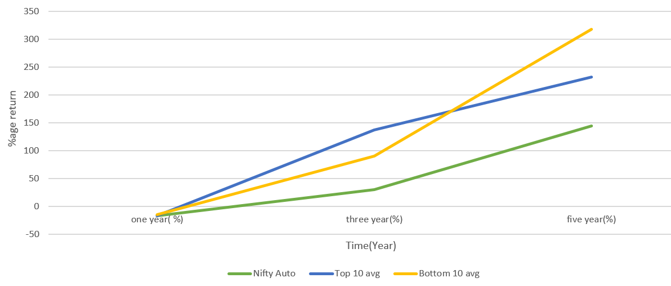
FEB 2019
STATIC EQUAL WEIGHTED
 | one year(%) | three year(%) | five year(%)
Nifty Auto | -17.37 | 29.51 | 144.31
Top 10 | -16.55 | 136.97 | 232.29
Bottom 10 | -14.79 | 89.78 | 317.90

Slide 33
FEB 2021
STATIC EQUAL WEIGHTED
TOP 10
Sharda Motor
Banco Products
Escorts Kubota
Fiem Industries
Subros
VST Till. Tract.
Amara Raja Ener.
Exide Inds.
India Motor Part
L G Balakrishnan
BOTTOM 10
Ashok Leyland
Bosch
Wheels India
Atul Auto
ZF Commercial
Minda Corp
Federal-Mogul Go
Tata Motors
Rane (Madras)
SML ISUZU

Slide 34
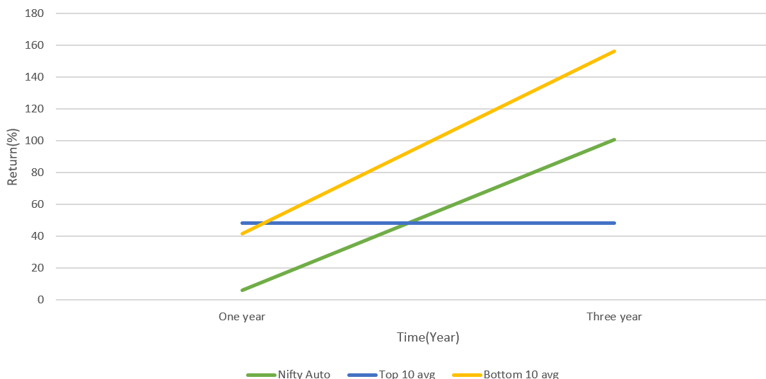
FEB 2021
STATIC EQUAL WEIGHTED
 | One year (%) | Three year (%)
Nifty Auto | 6.40 | 100.71
Top 10 | 48.43 | 48.43
Bottom 10 | 41.64 | 155.99

Slide 35
FEB 2022
STATIC EQUAL WEIGHTED
TOP 10
Automotive Stamp
India Motor Part
L G Balakrishnan
Sharda Motor
GNA Axles
Fiem Industries
Bajaj Auto
Talbros Auto.
Banco Products
Olectra Greentec
BOTTOM 10
Minda Corp
Automotive Axles
Maruti Suzuki
ZF Commercial
Ashok Leyland
Force Motors
Atul Auto
Rane (Madras)
Tata Motors
SML ISUZU

Slide 36
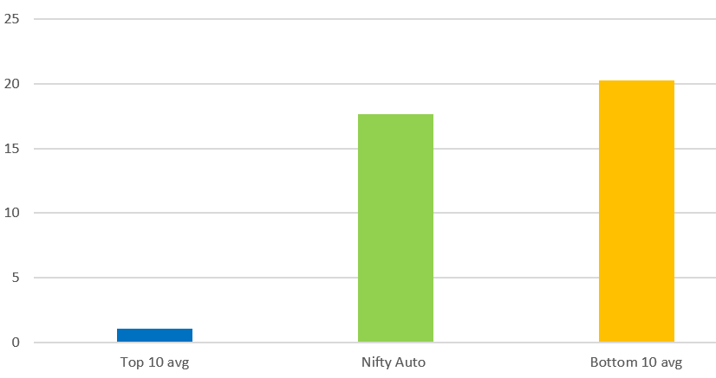
FEB 2022
STATIC EQUAL WEIGHTED
 | One year(%)
Nifty Auto | 17.66
Top 10 | 1.07
Bottom 10 | 20.26

Slide 37
JULY 2023
STATIC EQUAL WEIGHTED
TOP 10
Shriram Pistons
Banco Products
Pricol Ltd
Rane (Madras)
Olectra Greentec
JBM Auto
Sharda Motor
Fiem Industries
Rico Auto Inds
SML ISUZU
BOTTOM 10
Tata Motors
Atul Auto
India Nipp.Elec.
Subros
Steel Str. Wheel
Wheels India
Endurance Tech.
Ashok Leyland
Force Motors
Automotive Stamp

Slide 38
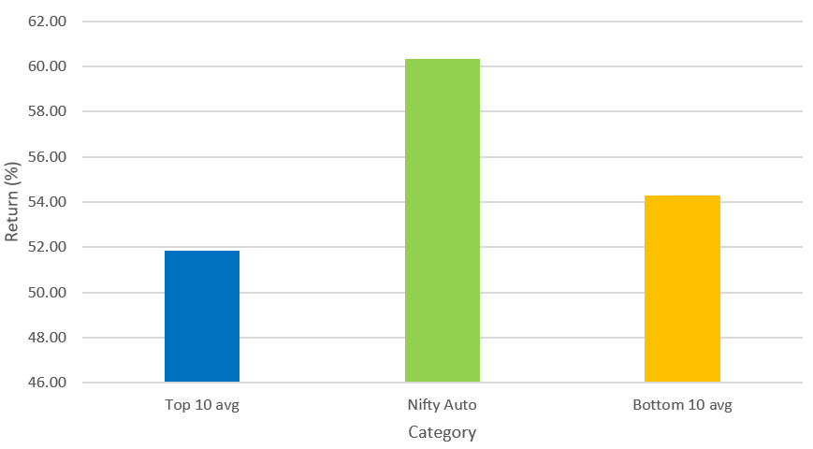
July 2023
STATIC EQUAL WEIGHTED
 | One year (%)
Nifty Auto | 60.33
Top 10 | 51.84
Bottom 10 | 54.30

Slide 39
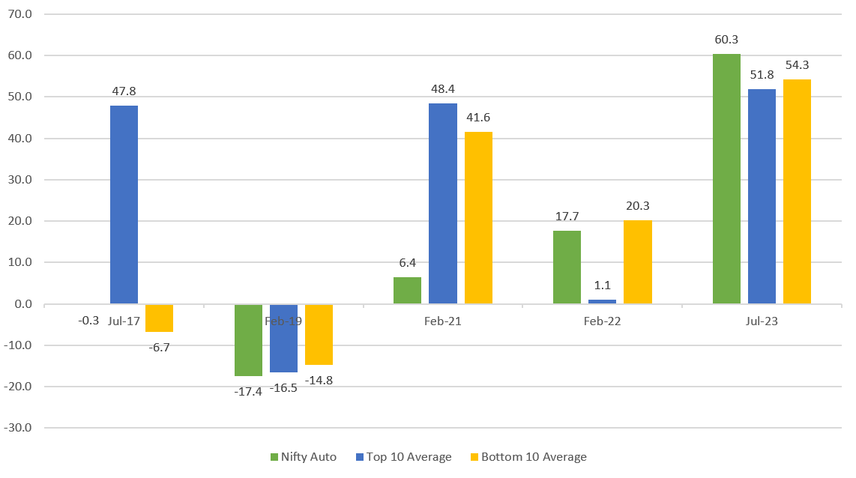
Static one year returns

Slide 40
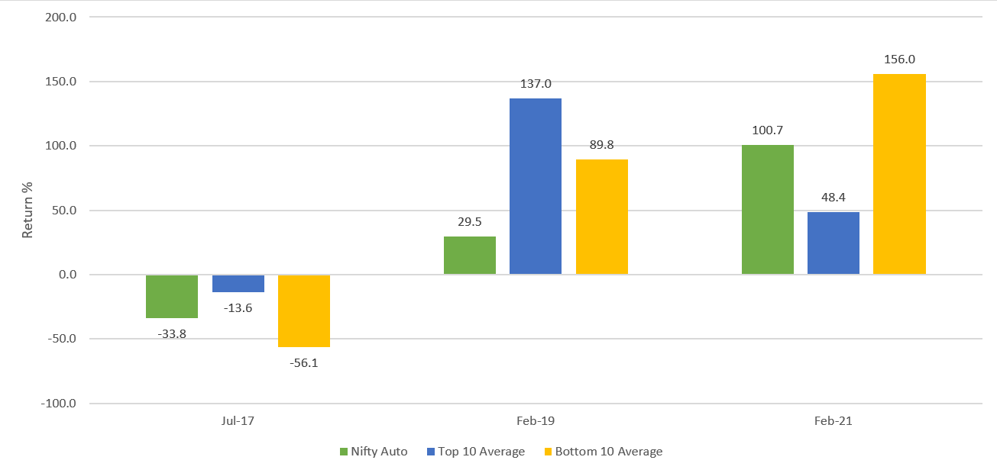
Static three year returns

Slide 41
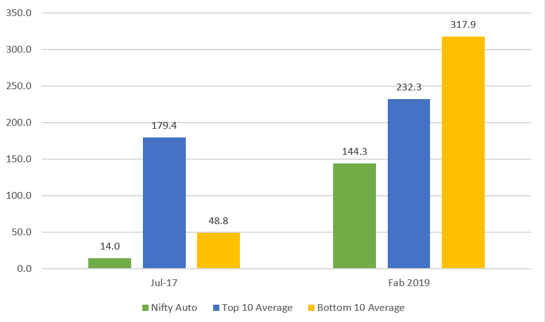
Static five year returns

Slide 42
Summary : static
One year return
Three year return
Five year return

Slide 43
Results:
DYNAMIC EQUAL WEIGHTED

Slide 44
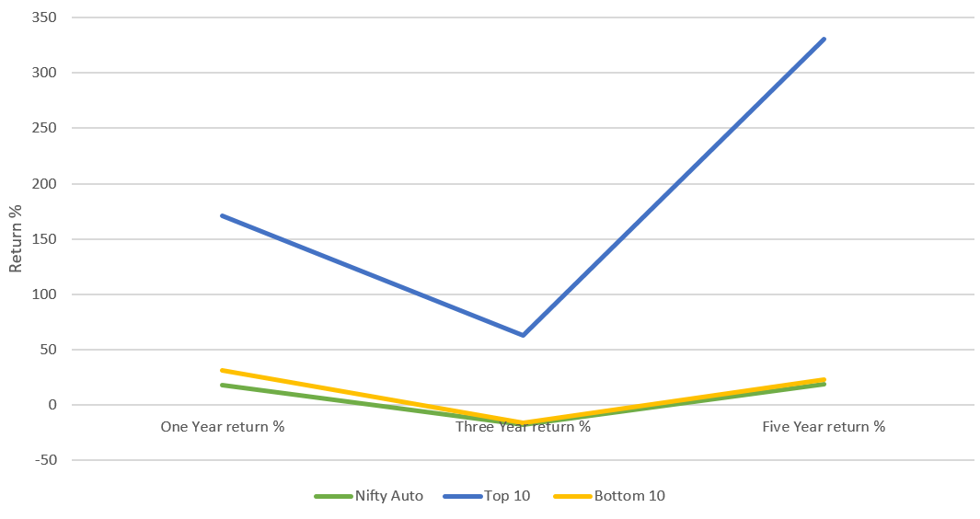
jan 2017
DYNAMIC EQUAL WEIGHTED
 | One Year return % | Three Year return % | Five Year return %
Top 10 | 171.03 | 63.08 | 330.79
Bottom 10 | 30.95 | -16.07 | 23.32
Nifty Auto | 18.03 | -17.8 | 18.97

Slide 45
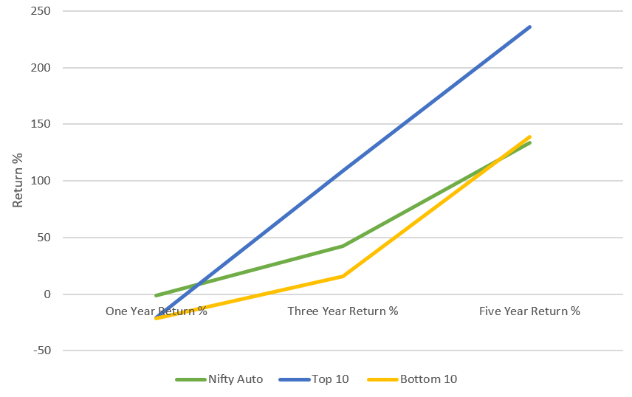
jan 2019
DYNAMIC EQUAL WEIGHTED
 | One Year Return % | Three Year Return % | Five Year Return %
Top 10 | -20.82 | 109.16 | 235.84
Bottom 10 | -21.17 | 15.84 | 139.09
Nifty Auto | -1.06 | 42.41 | 133.95

Slide 46
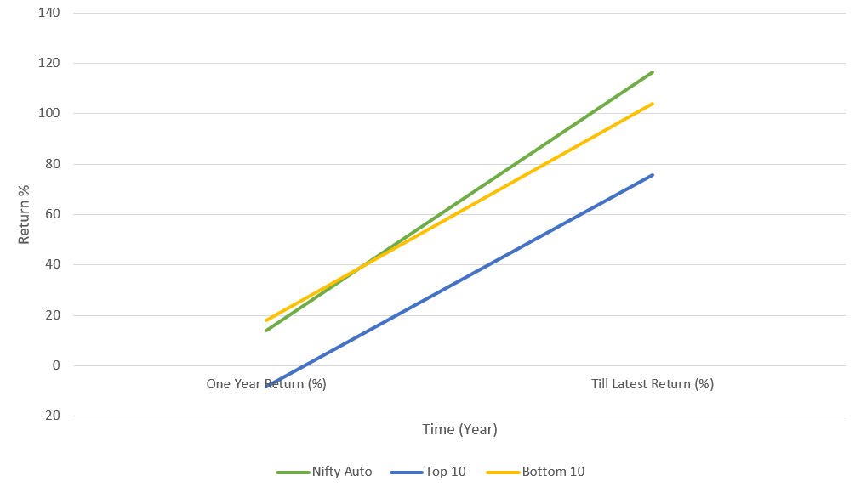
jan 2022
DYNAMIC EQUAL WEIGHTED
 | One Year Return (%) | Till Latest Return (%)
Top 10 | -8.39 | 75.65
Bottom 10 | 18.02 | 103.85
Nifty Auto | 13.85 | 116.32

Slide 47
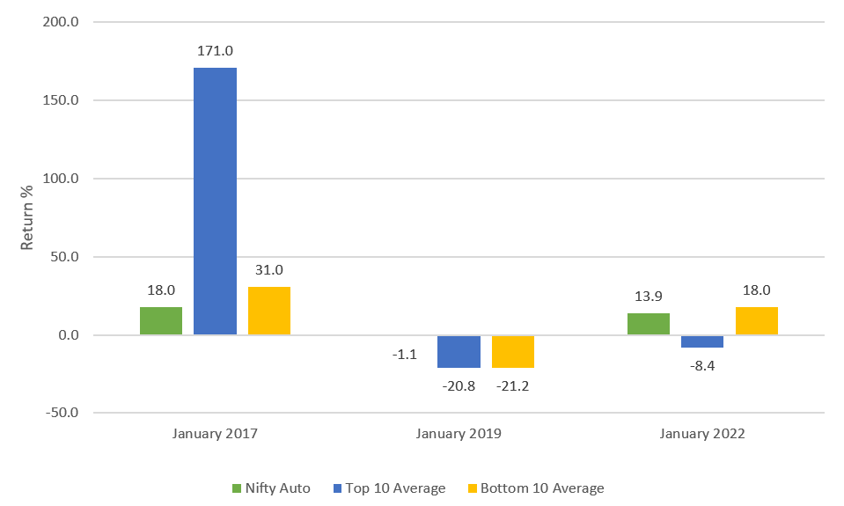
Dynamic one year returns

Slide 48
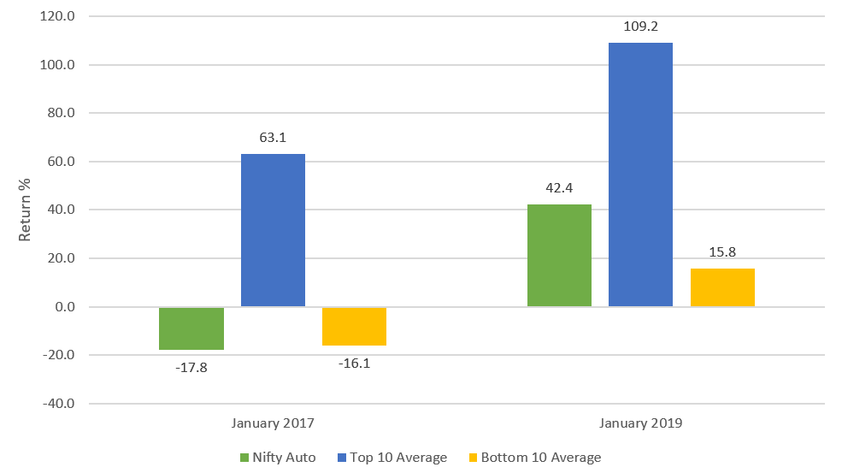
Dynamic Three year returns

Slide 49
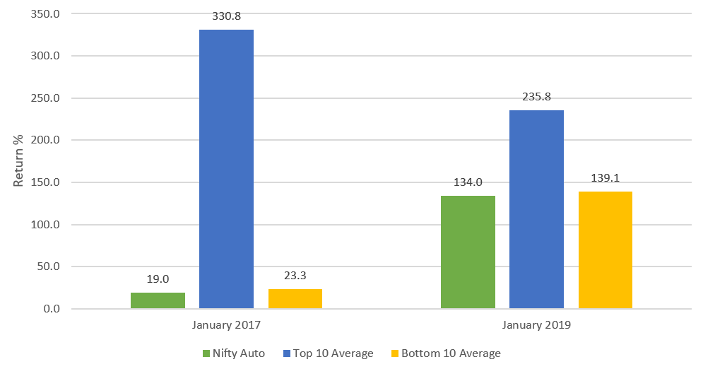
Dynamic five year returns

Slide 50
Summary : dynamic
One year return
Three year return
Five year return

Slide 51
Results:
STATIC QUALITY & VALUE EQUAL WEIGHTED

Slide 52

QUALITY AND VALUE IN EQUAL RATIO
Quality Factor Ratio = 0.5
Value Factor Ratio = 0.5
Growth Factor Ratio = 0
Momentum Factor Ratio = 0
Overall Z-Score = $0.5∗{ZScore}_{Quality}+0.5∗ZScore_{Value}$

Slide 53
JAN 2017
QUALITY & VALUE STATIC PORTFOLIO
TOP 10
Talbros Auto.
Uno Minda
Lumax Auto Tech.
Olectra Greentec
Banco Products
L G Balakrishnan
India Nipp.Elec.
Lumax Industries
Steel Str. Wheel
Hero Motocorp
BOTTOM 10
Amara Raja Ener.
TVS Motor Co.
JTEKT India
Bosch
ZF Commercial
Suprajit Engg.
Federal-Mogul Go
Ashok Leyland
Tata Motors
Automotive Stamp

Slide 54
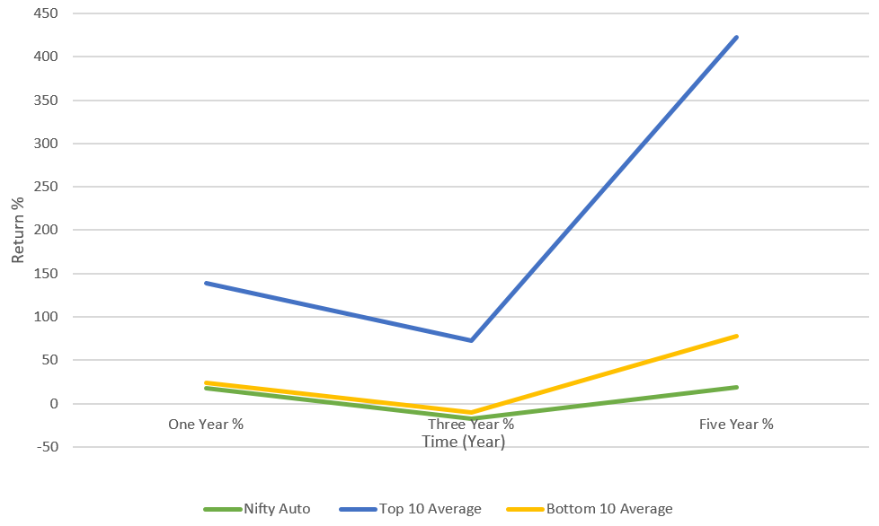
jan 2017
QUALITY & VALUE STATIC PORTFOLIO
 | One Year % | Three Year % | Five Year %
Nifty Auto | 18.03 | -17.8 | 18.97
Top 10 Average | 138.62 | 72.44 | 422.52
Bottom 10 Average | 24.16 | -10.21 | 77.24

Slide 55
JAN 2019
QUALITY & VALUE STATIC PORTFOLIO
TOP 10
Automotive Stamp
Banco Products
Lumax Auto Tech.
Eicher Motors
Hero Motocorp
Fiem Industries
Talbros Auto.
Atul Auto
Bajaj Auto
India Motor Part
BOTTOM 10
TVS Motor Co.
Wheels India
ZF Commercial
Subros
Minda Corp
JTEKT India
Federal-Mogul Go
Rane (Madras)
SML ISUZU
Tata Motors

Slide 56
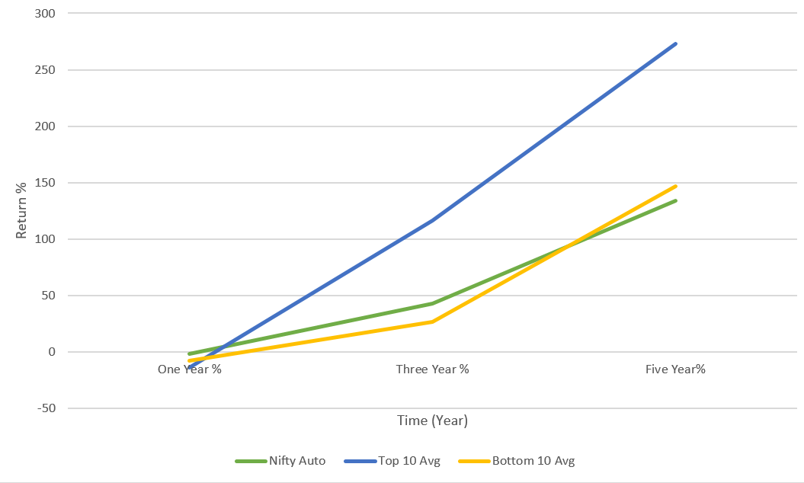
jan 2019
QUALITY & VALUE STATIC PORTFOLIO
 | One Year % | Three Year % | Five Year%
Nifty Auto | -1.6 | 42.41 | 133.95
Top 10 Avg | -14.11 | 116.29 | 273.27
Bottom 10 Avg | -7.98 | 26.57 | 146.79

Slide 57
JAN 2022
QUALITY & VALUE STATIC PORTFOLIO
TOP 10
Bajaj Auto
Hero Motocorp
India Motor Part
Fiem Industries
Talbros Auto.
L G Balakrishnan
Banco Products
Automotive Stamp
Shriram Pistons
Lumax Auto Tech.
BOTTOM 10
Ashok Leyland
TVS Motor Co.
JBM Auto
ZF Commercial
Uno Minda
Steel Str. Wheel
Rane (Madras)
Olectra Greentec
SML ISUZU
Tata Motors

Slide 58
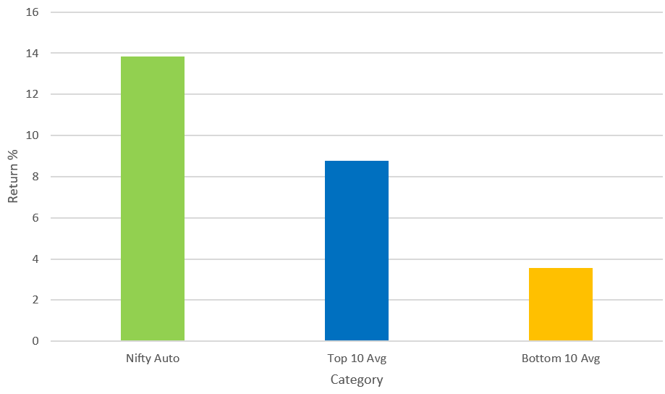
jan 2022
QUALITY & VALUE STATIC PORTFOLIO
 | One Year Return %
Nifty Auto | 13.85
Top 10 Avg | 8.76
Bottom 10 Avg | 3.56

Slide 59
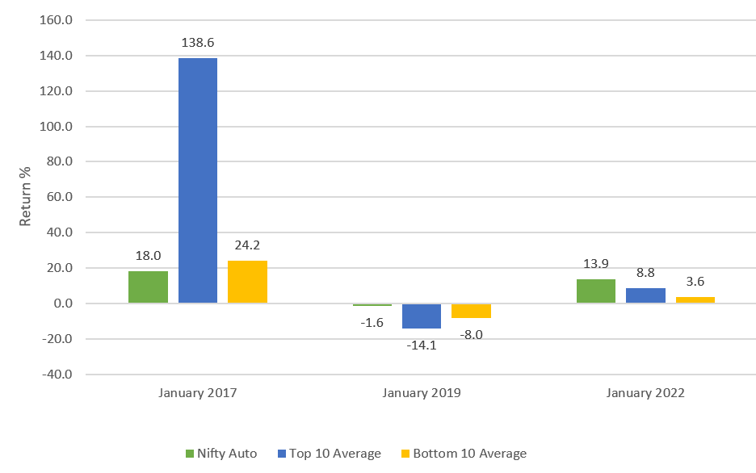
Quality+value one year returns

Slide 60
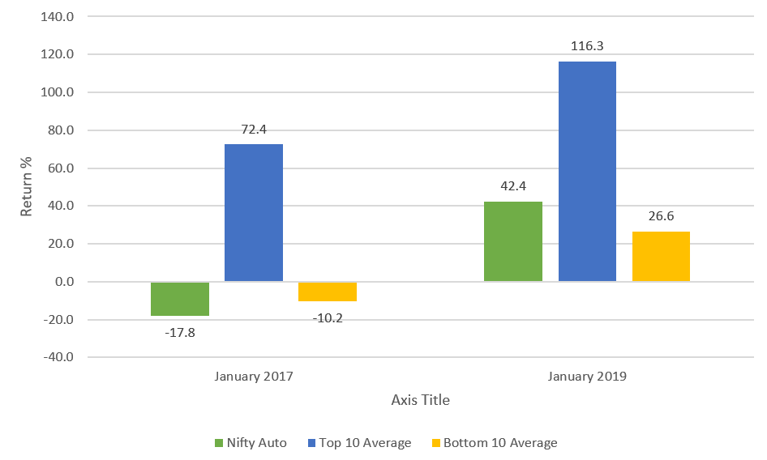
Quality+value three year returns

Slide 61
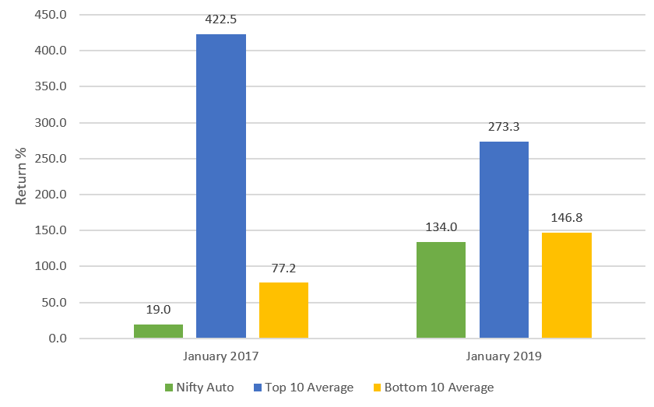
Quality+value three five returns

Slide 62
Summary : quality + value
One year return
Three year return
Five year return

Slide 63
Results:
STATIC GROWTH & MOMENTUM EQUAL WEIGHTED

Slide 64

growth AND momentum IN EQUAL RATIO
Quality Factor Ratio = 0
Value Factor Ratio = 0
Growth Factor Ratio = 0.5
Momentum Factor Ratio = 0.5
Overall Z-Score = $0.5∗{ZScore}_{Growth}+0.5∗ZScore_{Momentum}$

Slide 65
JAN 2017
GROWTH & MOMENTUM STATIC PORTFOLIO
TOP 10
Sundram Fasten.
Subros
Escorts Kubota
Uno Minda
Lumax Industries
Rico Auto Inds
Suprajit Engg.
Olectra Greentec
Fiem Industries
Jamna Auto Inds.
BOTTOM 10
Eicher Motors
Bosch
India Motor Part
Bajaj Auto
Talbros Auto.
Minda Corp
Automotive Stamp
Atul Auto
M & M
Tata Motors

Slide 66
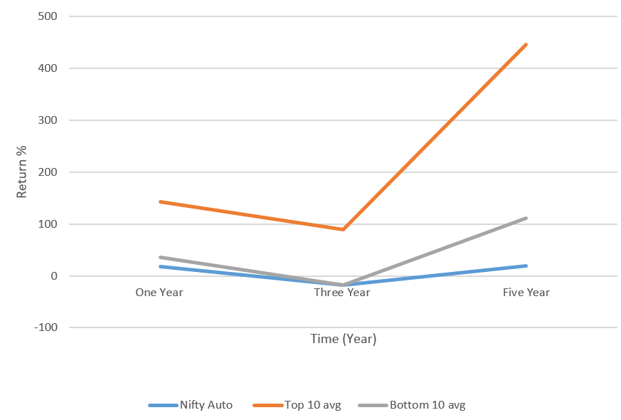
jan 2017
GROWTH & MOMENTUM STATIC PORTFOLIO
 | One Year % | Three Year % | Five Year%
Nifty Auto | 18.03 | -17.8 | 18.97
Top 10 avg | 143.13 | 89.60 | 445.98
Bottom 10 avg | 35.75 | -17.39 | 110.96

Slide 67
JAN 2019
GROWTH & MOMENTUM STATIC PORTFOLIO
TOP 10
Lumax Auto Tech.
Automotive Axles
Exide Inds.
Jamna Auto Inds.
M & M
Subros
Olectra Greentec
Wheels India
ZF Commercial
Sundram Fasten.
BOTTOM 10
L G Balakrishnan
Atul Auto
SML ISUZU
Eicher Motors
JBM Auto
Fiem Industries
Rane (Madras)
Banco Products
VST Till. Tract.
Tata Motors

Slide 68
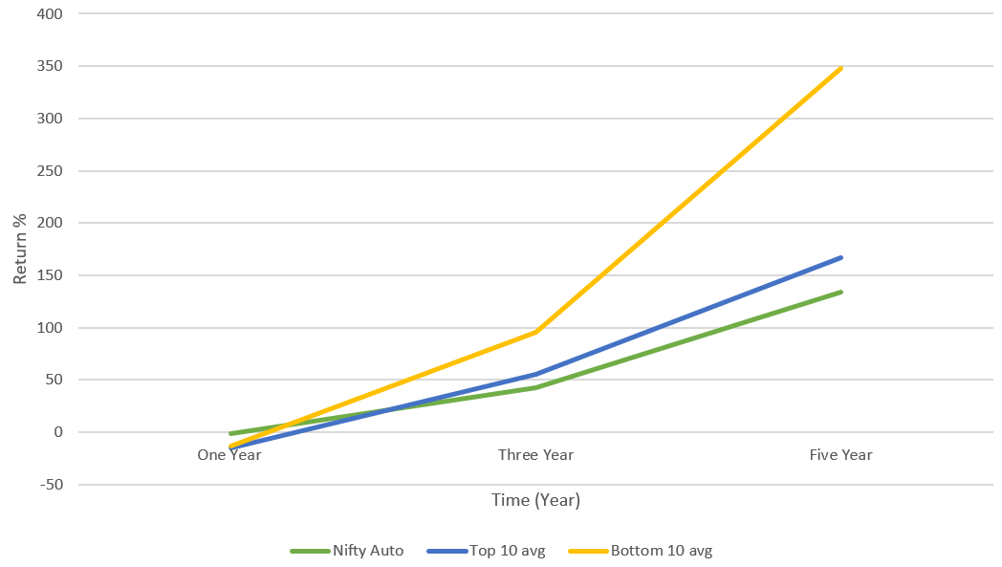
jan 2019
GROWTH & MOMENTUM STATIC PORTFOLIO
 | One Year % | Three Year % | Five Year %
Nifty Auto | -1.6 | 42.41 | 133.95
Top 10 avg | -15.27 | 55.64 | 166.58
Bottom 10 avg | -13.58 | 95.52 | 348.17

Slide 69
JAN 2022
GROWTH & MOMENTUM STATIC PORTFOLIO
TOP 10
Olectra Greentec
Automotive Stamp
Steel Str. Wheel
Sharda Motor
JBM Auto
GNA Axles
L G Balakrishnan
Escorts Kubota
Uno Minda
Talbros Auto.
BOTTOM 10
Maruti Suzuki
Hero Motocorp
Federal-Mogul Go
Automotive Axles
Tata Motors
Rane (Madras)
Ashok Leyland
Force Motors
Atul Auto
SML ISUZU

Slide 70
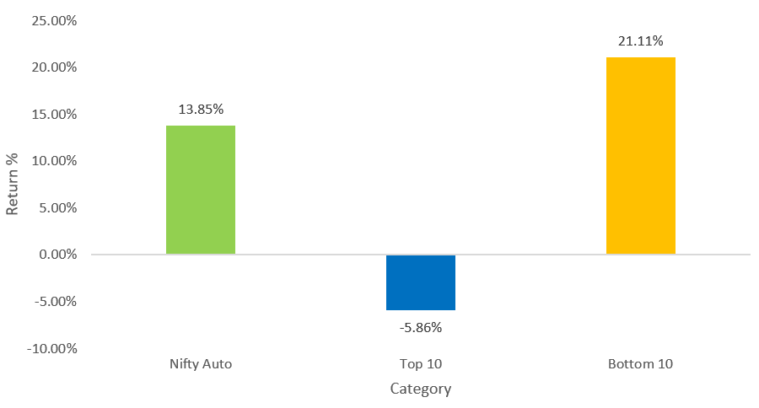
jan 2022
GROWTH & MOMENTUM STATIC PORTFOLIO
 | One Year Return
Top 10 | -5.86%
Nifty Auto | 13.85%
Bottom 10 | 21.11%

Slide 71
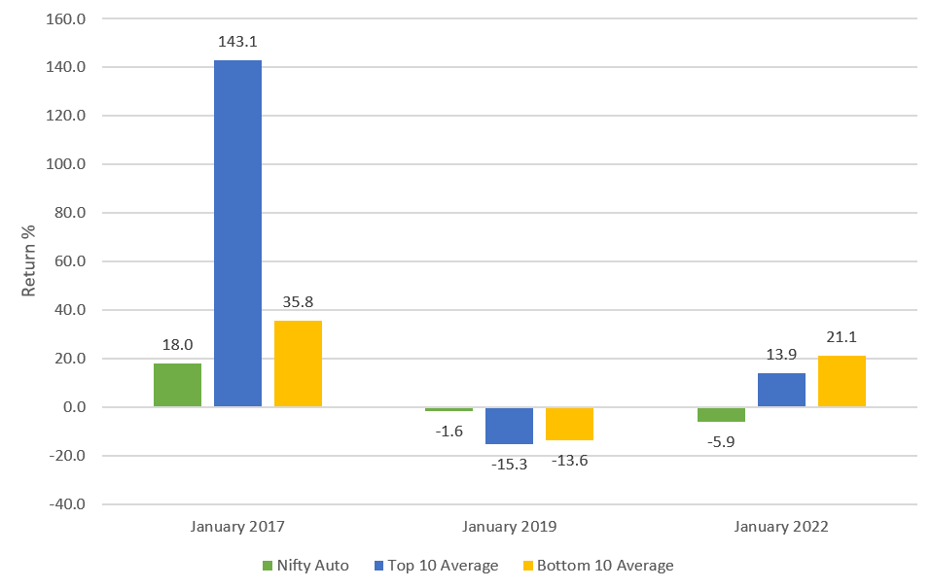
Growth+momentum one year returns

Slide 72
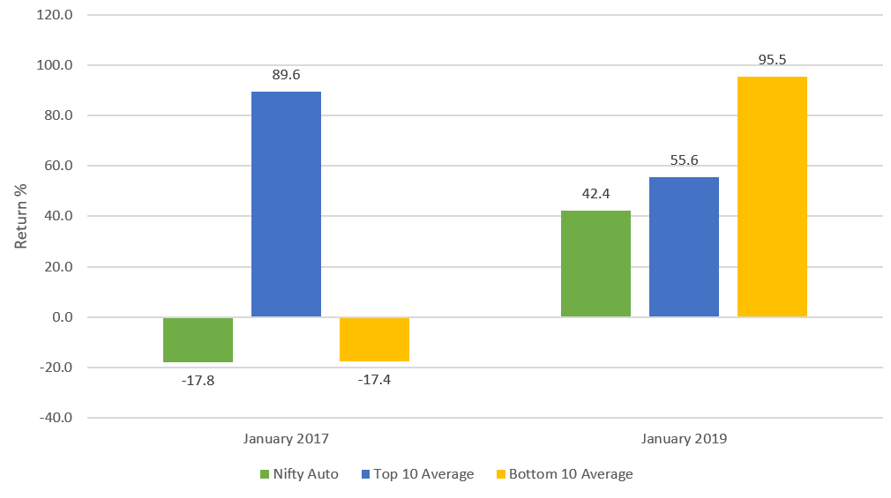
Growth+momentum three year returns

Slide 73
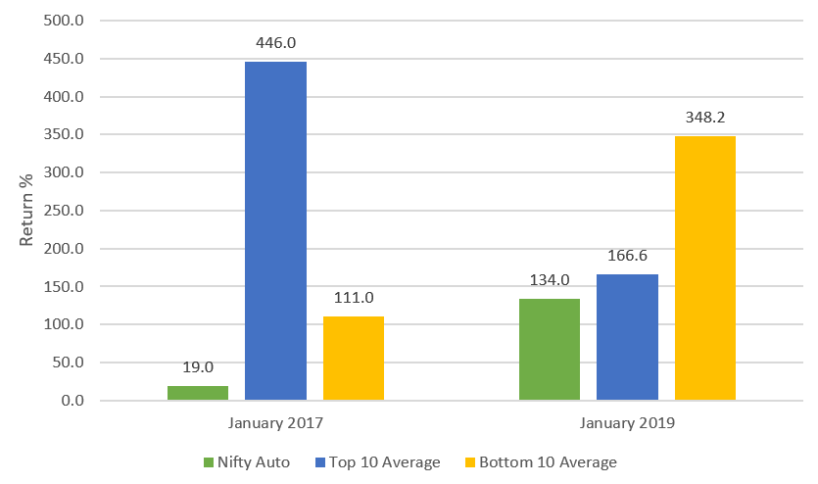
Growth+momentum five year returns

Slide 74
Summary : growth + momentum
One year return
Three year return
Five year return

